Slide 1


Paragraph Writing

Slide 2
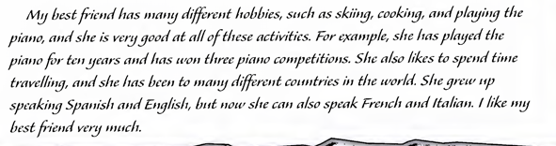
A paragraph is a series of sentences that are organized and coherent, and are all related to a single topic.

Slide 3
Paragraph
A paragraph is a collection of sentences that deal with one subject.
All paragraphs contain a topic sentence, which is often, but not always,
the first. Other components vary according to the nature of the topic.
Introductory paragraphs often contain definitions, and descriptive
paragraphs include a lot of detail. Other sentences give examples and offer reasons and restatements.

Slide 4
Read the following Paragraph.
1. The way we use banks is currently changing.2. This is partly because of
the introduction of new technology in the last ten years.3. The personal
computer and the internet, for instance, allow customers to view their
accounts at home and perform operations such as moving money
between accounts.4. At the same time banks are being reorganised in
ways that affect both customers and staff.5. In the past five years over
3,000 bank branches have closed in Britain.6.The banks have discovered that staffing call centres is cheaper than running a branch network.

Slide 5
The structure of a paragraph is:
1. Topic sentence - The way we use banks …
2. Reason - This is partly because …
3. Example - The personal computer …
4. Details - At the same time banks …
5. Further details - In the past five …
6. Reason - The banks have discovered …

Slide 6
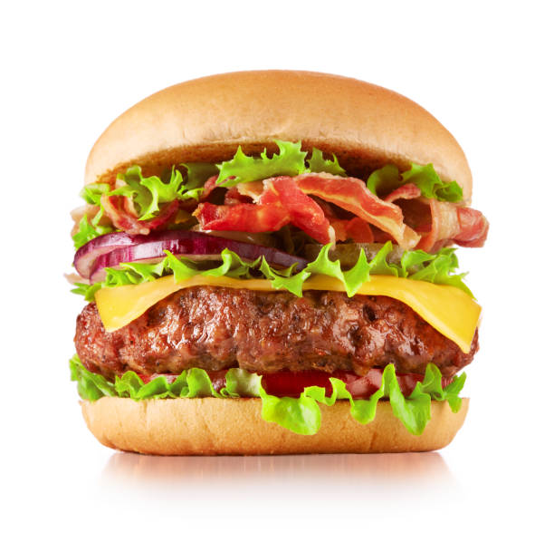

Slide 7
Paragraph Writing
There are three parts of paragraph writing:
Topic Sentence / Main Idea
The topic sentence tells what topic the paragraph is going to discuss.
It is mostly place in the beginning of the paragraph.
Supporting Details
The supporting sentences give details about the topic.
They come after the topic sentence, making up the body of a paragraph.
Concluding Sentence
The concluding sentence summarizes the main points or restates the topic sentence in different words.

Slide 8
Paragraph Format
Topic Sentence
Supporting Details
Examples
Concluding Sentence

Slide 9
Example
Canada is one of the best countries in the world due to its health care system, standard of education, and its urban centres. First, Canada has a universal health care system which “comprehensive coverage for medically necessary hospital and physician services”. This allows all Canadians to have access to medical services regardless of their income or geographical location in the country. Second, Canada has a high standard of education that is also publically funded by all levels of government from kindergarten to secondary levels and has resulted in a 99% national literacy rate. Finally, Canada's cities are clean and efficiently managed with both Calgary, Alberta and Ottawa, Ontario ranking first and fourth on the Sierra Club’s cleanest cities in the world. Overall, Canada has more to offer with its health care, education, and cities that would be a wonderful for anyone anywhere on the planet or in orbit above it.

Slide 10
This paragraph can be analysed:
Topic Sentence : Canada is one of the best countries in the world due to its health care system, standard of education, and its urban centres.
Reason 1: Canada has a universal health care system which “comprehensive coverage for medically necessary hospital and physician services”.
Example: This allows all Canadians to have access to medical services regardless of their income or geographical location in the country.
Reason 2: Canada has a high standard of education
Example: It is also publically funded by all levels of government from kindergarten to secondary levels and has resulted in a 99% national literacy rate.
Reason 3 : Canada's cities are clean and efficiently managed
Example : Calgary, Alberta and Ottawa, Ontario ranking first and fourth on the Sierra Club’s cleanest cities in the world.
Summary: Canada has more to offer with its health care, education, and cities that would be a wonderful for anyone anywhere on the planet or in orbit above it.

Slide 11
This example shows that:
A paragraph is a group of sentences that deal with a single topic. Dividing up the text into paragraphs helps both writer and reader to follow the argument more clearly.
The length of paragraphs varies significantly according to text type, but should normally be no less than four or five sentences.
Usually (but not always), the first sentence introduces the topic. Other sentences may give definitions, examples, extra information, reasons, restatements and summaries.

Slide 12
Example
Use of the internet has grown very quickly. In 1983, there were 562 computers
connected to the Internet. By the turn of the century, there were 72.3 million
computers in 247 countries on-line. Experts say that the Internet is now growing at a rate of approximately 40 percent a year. As time goes on, the Internet is
becoming more and more popular.

Slide 13
Example
Canada is one of the best countries in the world due to its health care system, standard of education, and its urban centres. First, Canada has a universal health care system which “comprehensive coverage for medically necessary hospital and physician services”. This allows all Canadians to have access to medical services regardless of their income or geographical location in the country. Second, Canada has a high standard of education that is also publically funded by all levels of government from kindergarten to secondary levels and has resulted in a 99% national literacy rate. Finally, Canada's cities are clean and efficiently managed with both Calgary, Alberta and Ottawa, Ontario ranking first and fourth on the Sierra Club’s cleanest cities in the world. Overall, Canada has more to offer with its health care, education, and cities that would be a wonderful for anyone anywhere on the planet or in orbit above it.

Slide 14
Common Transitional Words and Phrases
The following list, categorized by type of relationship, provides examples of some common and useful transitional words and phrases.
cause and effect: consequently, therefore, accordingly, as a result, because, for this reason, hence, thus
sequence: furthermore, in addition, moreover, first, second, third, finally, again, also, and, besides, further, in the first place, last, likewise, next, then, too
comparison or contrast: similarly, also, in the same way, likewise, although, at the same time, but, conversely, even so, however, in contrast, nevertheless, nonetheless, notwithstanding, on the contrary, otherwise, still, yet
example: for example, for instance, in fact, indeed, of course, specifically, that is, to illustrate
purpose: for this purpose, for this reason, to this end, with this object
time or location: nearby, above, adjacent to, below, beyond, farther on, here, opposite to, there, to the south, before, after, later, afterward, immediately, in the meantime, meanwhile, now, since, soon, then, while

Slide 15
Example
Germany invaded Poland on September 1, 1939. Consequently, France and the United Kingdom declared war on Germany. The Soviet Union initially worked with Germany in order to partition Poland. However, Germany invaded the Soviet Union in 1941.

Slide 16
Effective Paragraphs Have Unity and Arranged Logically
Transitions are words, phrases, or clauses that lead your reader from one idea to
another.
Without Transitions
Most films are structured much like a short story. The film begins with an opening scene that captures the audience’s attention. The writers build up tension, preparing for the climax of the story. They complicate the situation by revealing other elements of the plot, perhaps by introducing a surprise or additional characters. They introduce a problem. It will be solved either for the betterment or to the detriment of the characters and the situation. A resolution brings the film to a close.

Slide 17
With Transitions
Most films are structured much like a short story. The film begins with an opening scene that captures the audience’s attention. Gradually, the writers build up tension, preparing for the climax of the story. Soon after the first scene, they complicate the situation by revealing other elements of the plot, perhaps by introducing a surprise or additional characters. Next, they introduce a problem. Eventually, the problem will be solved either for the betterment or to the detriment of the characters and the situation. Finally, a resolution brings the film to a close.

Slide 18
Activity
Transition

Slide 19
We have a mouse in the house. Unfortunately/Therefore, we should get a cat.
Megan got into a car accident. Furthermore/As a result, her insurance rate increased.
Michael is very athletic and plays on the school basketball team. However/In addition, his brother just stays at home and plays video games all day.
There are many occupations today. Such as/For Example, you can become a doctor, engineer, teacher, artist, athlete, musician, or chef, just to name a few.
The US government has been spending its money recklessly for too long. Furthermore/As a result, the plans that Congress proposes are destined to put the nation at great economic risk in the future.

Slide 20
Keys
1. Therefore
2. As a result
3. However
4. for example
5. Furthermore

Slide 21
Topic Sentence / Main Idea
The topic sentence tells what topic the paragraph is going to discuss.
It has two parts: a topic and a controlling idea.
The controlling idea tells what the paragraph will say about the topic.
Topic + Controlling idea

Slide 22
Topic + Controlling idea
The invention of the light bulb
(Topic)
Changed the world in many ways
(Controlling idea)
The invention of the light bulb changed the world in many ways.
The Topic/ Subject can be fairly broad. The controlling idea will limit the subject.
“There are benefits to making your own ice cream.”
The subject/topic is “making ice cream”
The controlling idea is “benefits”
The topic or subject making ice cream is control by benefits.

Slide 23
Too GENERAL
Marriage is an event in a person's life.
This is too general because there is no specific controlling idea. The reader has no idea what the paragraph will say about marriage except that it happens.
Too Specific
The average age for people in the United States to marry in the year 2000
was 25 for a woman and 27 for a man.

Slide 24
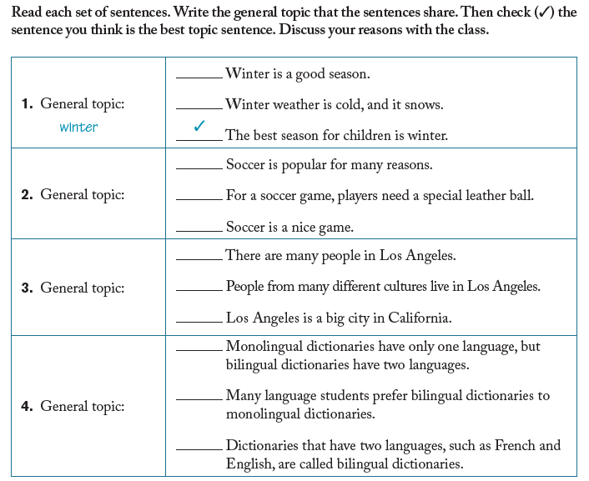

Slide 25
For example, “Libraries have books” is not a good topic sentence. The information in this sentence is true, but it is a fact and there is little to say about it.
It is specific
“Tea is delicious” is not a good topic sentence because the information in the sentence is too general. If you want to write a paragraph about tea, make your topic sentence more specific, such as “Green tea has many health benefits.”

Slide 26
It is not too specific
“This dictionary contains more than 42,000 words” limits the topic too much. There is nothing else for the writer to say, so the paragraph cannot continue.

Slide 27
Circle the topic and underline the controlling idea
The new test has three sections dealing with three important skills.
The shocking crash of the airplane off the coast of Florida confused investigators.
Crossword puzzles are not only educational and fun, but also addictive.
Recent research has shown once again that eating dark green, leafy vegetables such as broccoli and cabbage may reduce the risk of some types of cancer.
.

Slide 28
The new test has three sections dealing with three important skills.
The shocking crash of the airplane off the coast of Florida confused investigators.
Crossword puzzles are not only educational and fun, but also addictive.
Recent research has shown once again that eating dark green, leafy vegetables such as broccoli and cabbage may reduce the risk of some types of cancer.

Slide 29
These topic sentences are too general. Using the same topic, write a topic sentence with a clear controlling idea
Flowers are beautiful.
Cats are nice.
Reading blogs is interesting.
Running is a hobby

Slide 30
I usually go skiing every weekend in the winter even though it is expensive. I love the feeling of flying down a mountain. The views are beautiful from the top of a mountain and along the trails. Even the danger of falling and getting hurt can’t keep me away from the slopes on a winter day.
a) Skiing is expensive.
b) Skiing is my favourite sport.
c) Skiing is dangerous.

Slide 31
I usually go skiing every weekend in the winter even though it is expensive. I love the feeling of flying down a mountain. The views are beautiful from the top of a mountain and along the trails. Even the danger of falling and getting hurt can’t keep me away from the slopes on a winter day.
a) Skiing is expensive.
b) Skiing is my favourite sport.
c) Skiing is dangerous.

Slide 32
Topic sentence
___________________________________________North Americans send cards for many occasions. They send cards to family and friends on birthdays and holidays. They also send thank-you cards, get well cards, graduation cards, and congratulation cards. It is very common to buy cards in stores and send them through the mail, but turning on the computer and sending cards over the Internet is also popular.
a) Sending cards is very popular in North America.
b) Birthday cards are the most popular kind of card.
c) It is important to send thank-you cards.

Slide 33
Topic sentence
___________________________________________North Americans send cards for many occasions. They send cards to family and friends on birthdays and holidays. They also send thank-you cards, get well cards, graduation cards, and congratulation cards. It is very common to buy cards in stores and send them through the mail, but turning on the computer and sending cards over the Internet is also popular.
a) Sending cards is very popular in North America.
b) Birthday cards are the most popular kind of card.
c) It is important to send thank-you cards.

Slide 34
Topic sentence
______________________________________________________For example, Kansas City, in the very center of the United States, is known for its beef, and Kansas City barbecue is everyone's favorite way to enjoy it. In Boston, people love baked beans. In the Southwest, chili, a stew made of meat, beans, tomatoes, and hot peppers, is the regional dish. Wisconsin, a state with many dairy farms, is famous for its cheese. Go to Maryland and Virginia for crab cakes and to the Northeast for clam chowder and maple syrup. Indeed, many U.S. cities and regions have a special food for everyone to enjoy.
There is a variety of food in the United States.
Food in the United States varies from sweet desserts to spicy stews.
Different regions of the United States have their own traditional foods.
Food in the United States is quite delicious.

Slide 35
Topic sentence
______________________________________________________For example, Kansas City, in the very center of the United States, is known for its beef, and Kansas City barbecue is everyone's favorite way to enjoy it. In Boston, people love baked beans. In the Southwest, chili, a stew made of meat, beans, tomatoes, and hot peppers, is the regional dish. Wisconsin, a state with many dairy farms, is famous for its cheese. Go to Maryland and Virginia for crab cakes and to the Northeast for clam chowder and maple syrup. Indeed, many U.S. cities and regions have a special food for everyone to enjoy.
There is a variety of food in the United States.
Food in the United States varies from sweet desserts to spicy stews.
Different regions of the United States have their own traditional foods.
Food in the United States is quite delicious.

Slide 36
I enjoy summer sports like water skiing and baseball. The weather is usually sunny and hot, so I can go to the beach almost every day. Gardening is my hobby and I spend many summer days working in my garden. Unfortunately, the days pass too quickly in summer.
a) I like to garden in summer.
b) Summer is my favourite season.
c) Summer is to short.

Slide 37
I enjoy summer sports like water skiing and baseball. The weather is usually sunny and hot, so I can go to the beach almost every day. Gardening is my hobby and I spend many summer days working in my garden. Unfortunately, the days pass too quickly in summer.
a) I like to garden in summer.
b) Summer is my favourite season.
c) Summer is to short.

Slide 38
__________________________________________________. First of all, we need money to repair old roads and build new roads. We also need more to pay teachers’ salaries and to pay for services such as trash collection. Finally, more tax money is needed to give financial help to the poor citizens of the city. It is clear that the city will have serious problems if taxes are not raised soon.
a) We should raise city taxes.
b) City taxes are too high.
c) City taxes pay for new roads.

Slide 39
__________________________________________________. First of all, we need money to repair old roads and build new roads. We also need more to pay teachers’ salaries and to pay for services such as trash collection. Finally, more tax money is needed to give financial help to the poor citizens of the city. It is clear that the city will have serious problems if taxes are not raised soon.
a) We should raise city taxes.
b) City taxes are too high.
c) City taxes pay for new roads.

Slide 40
There are many reasons I hate my apartment. The plumbing doesn’t work properly and the landlord refuses to fix it. I also have noisy neighbors who keep me up all night. Furthermore, there are so many bugs in my apartment that I could start an insect collection. I really want to move

Slide 41
Separate topic sentence, transitions and concluding sentence.
Vegetables and fruits are an important part of a healthy diet. First, fruits and vegetables are packed with the vitamins and minerals you need to keep your body functioning smoothly. In addition, they give you the carbohydrates you need for energy. Fruits and vegetables have lots of fiber to help your digestive system work properly. Finally, many scientists believe that the nutrients in fruits and vegetables can help fight diseases. If you eat a diet rich in fruits and vegetables, you’ll be on the road to better health.

Slide 42
There are several advantages to living and working in a small town.
Most UK universities require an IELTS score of 6.5 for a number of key reasons.

Slide 43
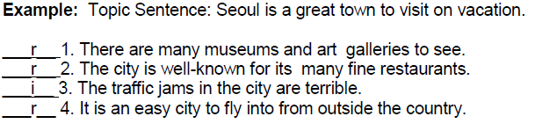
Supporting Details
The sentences that follow the topic sentence are the supporting sentences. All the supporting sentences should be about the topic only. If the sentences talk only about something other than the topic sentence, it is irrelevant and should be deleted. The supporting sentences provide more detail about the topic by using examples and facts.

Slide 44
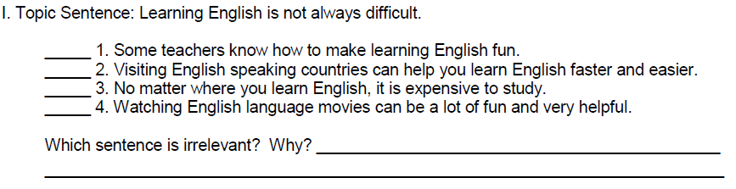
Supporting Details

Slide 45
The students in the class come from many different parts of the world. Some are from European countries, such s France, Spain, and Italy. Others are from Middle Eastern countries like Saudi Arabia and Israel. Still other students were born in Asian countries, including Japan and Korea. Korean food is delicious. The largest number of students is from Latin American countries like Mexico, Venezuela and Peru. The class is an interesting mix of people from many different countries.

Slide 46
The students in the class come from many different party of the world. Some are from European countries, such s France, Spain, and Italy. Others are from Middle Eastern countries like Saudi Arabia and Israel. Still other students were born in Asian countries, including Japan and Korea. Korean food is delicious. The largest number of students is from Latin American countries like Mexico, Venezuela and Peru. The class is an interesting mix of people from many different countries.

Slide 47
There are several ways people can conserve natural resources. One way is to turn lights off and appliances when they are not in use. Another way is to drive cars less. My favourite kind of car is convertible. People can also protect their houses better. Finally, by reusing things like bottles and plastic bags, people can reduce the amount of waste. By practicing these simple guidelines, we can save our natural resources.

Slide 48
There are several ways people can conserve natural resources. One way is to turn lights off and appliances when they are not in use. Another way is to drive cars less. My favourite kind of car is convertible. People can also protect their houses better. Finally, by reusing things like bottles and plastic bags, people can reduce the amount of waste. By practicing these simple guidelines, we can save our natural resources.

Slide 49
Writing Supporting Sentences
Owning a small car has several advantages.
__A small car is easier to park _________________________________________________
__________________________________________________________________________
__________________________________________________________________________
__________________________________________________________________________
__________________________________________________________________________
A college education is important for these reasons.
_It prepares you for a career __________________________________________________
__________________________________________________________________________
__________________________________________________________________________
__________________________________________________________________________
__________________________________________________________________________

Slide 50
Conclusion Signals
Followed by a Comma | No Comma
All in all 7. In summary, In brief, 8. To conclude, In conclusion, 9. To summarize, Indeed, 10. To sum up, In short, In summary, | 2. It is clear that……. These examples show that……… You can see that…….
To summarize, Japanese food is both beautiful to look at and delicious to eat. Indeed, many U.S. cities and regions have a special food for everyone to enjoy. | 2. It is clear that fad diets don't work and may even damage a dieter's health.

Slide 51
Conclusion
Remind your reader of the main idea by one of the following methods ..
• Repeat the idea in the topic sentence in different words. Do not just copy the topic sentence.
Topic Sentence:
Successful bidding on eBay requires patience and strategy.
Fortunately, my parents were very strict with me when I was a child.
Concluding Sentence:
In conclusion, wait patiently and place your bid with precision timing,
and you will be the winning bidder every time.
Looking back, I am not sorry that my parents were strict with me because I think it was the best way to bring up a child.

Slide 52
There are many reasons why I like wearing a uniform to school. First of all, it saves time. I don’t have to spend time picking out my clothes every morning. Wearing a uniform also saves money. It’s cheaper to purchase a new uniform than to go out and buy lots of school clothes. In addition, I don’t have the pressure of keeping up with the latest styles. Most importantly, wearing a school uniform gives me a sense that I belong. I really think that it adds to the feeling of school spirit and community. __________________________________

Slide 53
Practice: Animals Captivity
Animals living in modern zoos enjoy several advantages over animals in the wild. The first advantage is that zoo animals are separated from their natural predators.1 They are protected, so they live without risk of being attacked. Another advantage is that someone feeds them regularly, so they do not have to hunt for food. Also, they do not suffer times when food is hard to find. A third advantage of living in zoos is that veterinarians give animals regular checkups, and sick animals get prompt medical attention. __________________________________________________________.
1. In conclusion, because all their needs are taken care of, most zoo animals
are healthy and contented.
2. In conclusion, living in a zoo has many advantages for animals, but it also
has some disadvantages.
3. In conclusion, zoos keep animals safe from predators.

Slide 54
Practice: Animals Captivity
Animals living in modern zoos enjoy several advantages over animals in the wild. The first advantage is that zoo animals are separated from their natural predators.1 They are protected, so they live without risk of being attacked. Another advantage is that someone feeds them regularly, so they do not have to hunt for food. Also, they do not suffer times when food is hard to find. A third advantage of living in zoos is that veterinarians give animals regular checkups, and sick animals get prompt medical attention. __________________________________________________________.
1. In conclusion, because all their needs are taken care of, most zoo animals
are healthy and contented.
2. In conclusion, living in a zoo has many advantages for animals, but it also
has some disadvantages.
3. In conclusion, zoos keep animals safe from predators.

Slide 55
Concluding Sentence
The college cafeteria is an inexpensive place to eat. For example, you can get a cheeseburger, French fries, and a soda for only $3.00. A slice of pizza is only $ 1 .50, and a cup of coffee is only 50¢. There is a daily special for about $2.50. It includes an entree, rice or potatoes, and a vegetable. The salad bar is the best deal of all . You get all you can eat for $2.00.
___________________________________________________________________________

Slide 56
The following sentences are a scrambled paragraph . Put the sentences in order
Step 1 Find the topic sentence.
Step 2 Find the concluding sentence.
Step 3 Then decide which sentences are supporting points and put them in
order. Look for the words First, Second, Third , and Finally.
Step 4 Decide which examples support which points.

Slide 57
Write a Paragraph
There are many benefits of doing job in early career?

Slide 58
References
Bailey, S. (2014). Academic writing: A handbook for International Students (4th ed.). Routledge.
Langan, J. (2011). College writing skills with Reading (8th ed.).
McGraw Hill.
Zemach, D. E., & Rumisek, L. A. (2005). Academic Writing: From Paragraph to Essay. Macmillan.

